Slide 1
ONMS Condition Report Questions
Category: Human Dimension
Q1. What are the states of influential human drivers and how are they changing?
Q2. What are the levels of human activities that may adversely influence water quality and how are they changing?
Q3. What are the levels of human activities that may adversely influence habitats and how are they changing?
Q4. What are the levels of human activities that may adversely influence living resources and how are they changing?
Q5. What are the levels of human activities that may adversely affect maritime archaeological resources and how are they changing?
Category: Water Quality
Q6. What is the eutrophic condition of sanctuary waters and how is it changing?
Q7. Do sanctuary waters pose risks to human health and how are they changing?
Q8. Have recent, accelerated changes in climate altered water conditions and how are they changing?
Q9. Are other stressors, individually or in combination, affecting water quality, and how are they changing?
Category: Habitat
Q10. What is the integrity of major habitat types and how are they changing?
Q11. What are contaminant concentrations in sanctuary habitats and how are they changing?
Category: Living Resources
Q12. What is the status of keystone and foundation species and how is it changing?
Q13. What is the status of other focal species and how is it changing?
Q14. What is the status of non-indigenous species and how is it changing?
Q15. What is the status of biodiversity and how is it changing?
Category: Maritime Archaeological Resources
Q16. What is the condition of known maritime heritage resources and how is it changing?

Slide 2
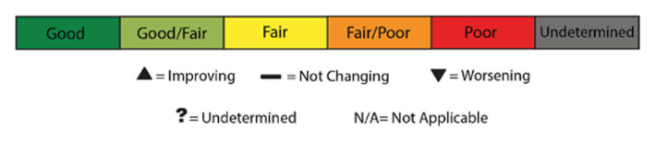
Question 8: Have recent, accelerated changes in climate altered water conditions and how are they changing?
Previous rating
2007 rating based on | Increasing number of warm-water events causing coral bleaching
The purpose of this question is to capture shifts in water quality, and associated impacts on sanctuary resources, due to climate change. Though temporal changes in climate have always occurred on Earth, evidence is strong that changes over the last century have been accelerated by human activities. Indicators of climate change in sanctuary waters include water temperature, acidity, sea level, upwelling intensity and timing, storm intensity and frequency, changes in erosion and sedimentation patterns, and freshwater delivery (e.g., rainfall patterns). Climate-related changes in one or more of these indicators can impact the condition of habitats, living resources, and maritime archaeological resources in sanctuaries.
Increasing water temperature has been linked to changing growth rates, reduced disease resistance, and disruptions in symbiotic relationships (e.g., bleaching on coral reefs), and changes in water temperature exposure may affect a species’ resistance or the capacity to adapt to disturbances. Acidification can affect the survival and growth of organisms throughout the food web, as well as the persistence of skeletal material after death (through changes in rates of dissolution and bioerosion). Recent findings also suggest acidification impacts at sensory and behavioral levels, which can alter vitality and species interactions. Sea level change alters habitats, as well as their use and persistence. Variations in the timing and intensity of upwelling is known to change water quality through factors such as oxygen content and nutrient flow, further disrupting food webs and the natural functioning of ecosystems. Changing patterns and intensities of storms alter community resistance and resilience within ecosystems that have, over long periods of time, adapted to such disturbances. Altered rates and volumes of freshwater delivery to coastal ecosystems affects salinity and turbidity regimes and can disrupt reproduction, recruitment, growth, disease incidence, phenology, and other important processes.
Notes:
2

Slide 3
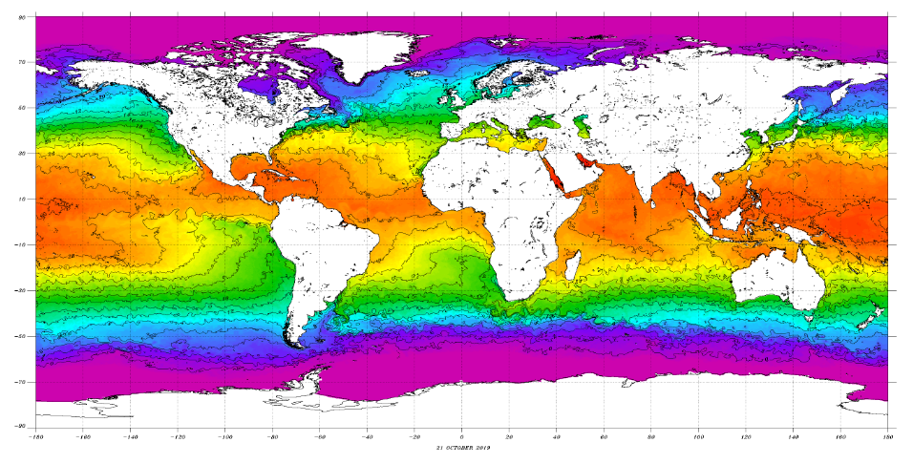
Question 8: Have recent, accelerated changes in climate altered water conditions and how are they changing?
Habitat:
All Shallow Habitats:
Rocky Shores, Sandy Shores and Reef Flat, Shallow Coral Reef, Mesophotic Coral Reef, Upper Pelagic
Source: NOAA
Indicator: Water Temperature

Slide 4
Question 8: Have recent, accelerated changes in climate altered water conditions and how are they changing?
Habitat: Coral Reefs
Indicator: Sea Surface Temperature
Sources: NOAA Coral Reef Watch
NOAA Climate Prediction Center

Slide 5
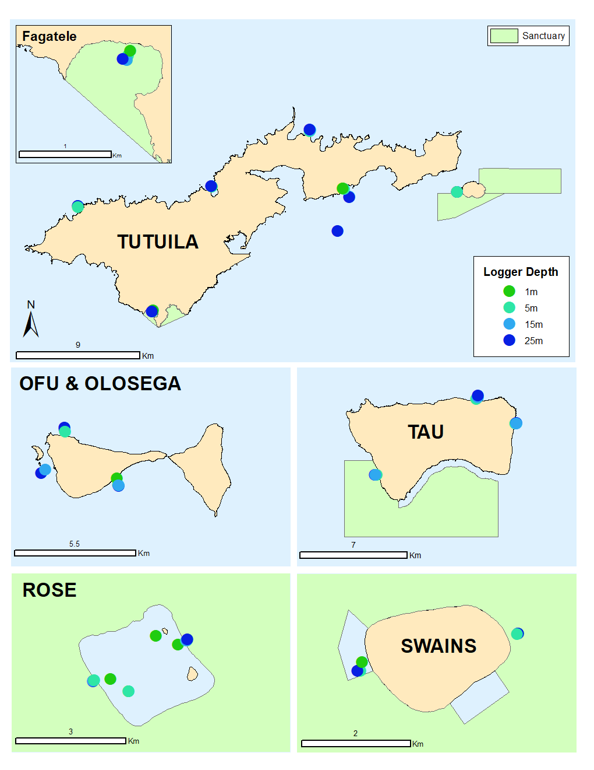
Question 8: Have recent, accelerated changes in climate altered water conditions and how are they changing?
Habitat: Coral Reefs
Indicator: Water Temperature
Spatial distribution and depth of subsurface temperature loggers maintained in American Samoa.
Temperature data were collected using high-accuracy temperature loggers (Sea-Bird Scientific®, models: SBE39 and SBE56). For reporting, temperature sensor deployments were grouped by site, and temperature data from successive deployments at each site were concatenated. Raw data were averaged hourly, and gaps of longer than one hour in the time-series (due to instrument failure or battery death) were padded with null values.
Source: ESD Report 2019
Notes:
next slide presents temperature data that was collected at these sites

Slide 6
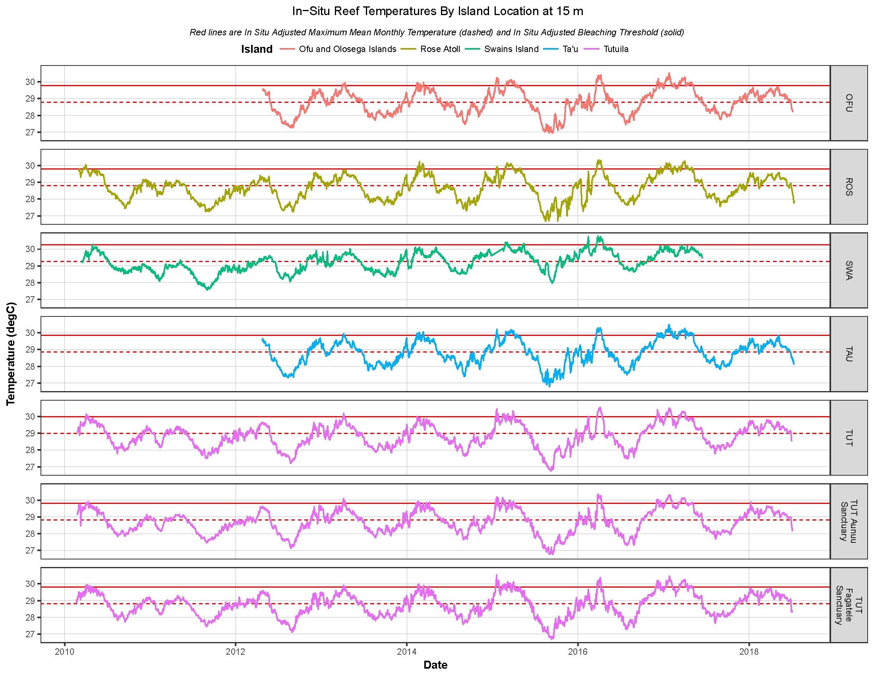
Question 8: Have recent, accelerated changes in climate altered water conditions and how are they changing?
up to 2018
Habitat: Coral Reefs
Indicator: Water Temperature
Water temperature at 15 m depth between 2010 and 2018.
CRAG dataloggers captured temperatures exceeding 34C during the 2105- 2016 thermal stress event.
Red lines: In-situ adjusted maximum monthly mean temperature (dashed); and in-situ adjusted bleaching threshold (solid);
bleaching threshold is defined as 1°C above the maximum monthly mean.
Red box: years where summer temperature was above bleaching threshold (2015 - 2017)
Source: ESD Report 2019
Notes:
The timing and magnitude of temperature patterns in the Territory are similar across islands and Sanctuary management areas. A strong seasonal cycle is evident, with the warmest temperatures occurring during summer months (Dec–Mar) and cooler temperatures observed in the winter (July–Sept).
During this warming event, Swains Island experienced the greatest thermal anomalies with water temperatures of almost 31°C and consequently widespread levels of coral bleaching (NOAA 2016
From the beginning of temperature data collection from 2010 through 2015, temperatures across all islands rarely exceeded the bleaching threshold —i.e., 1°C above the maximum monthly mean; and if exceeded, it was over a very narrow time period. In 2015–2017 however, summer temperatures exceeded the bleaching threshold for several months during each year. These sharp and repeated ocean temperature rises during the 2015–2016 El Niño caused prolonged thermal stress and subsequent coral bleaching, which was recorded by the coral demographic surveys in March–April 2015. During this warming event, Swains Island experienced the greatest thermal anomalies with water temperatures of almost 31°C and consequently widespread levels of coral bleaching (NOAA 2016). By the summer of 2018, the ocean warming event had receded and temperatures were mild, well within the typical range.

Slide 7
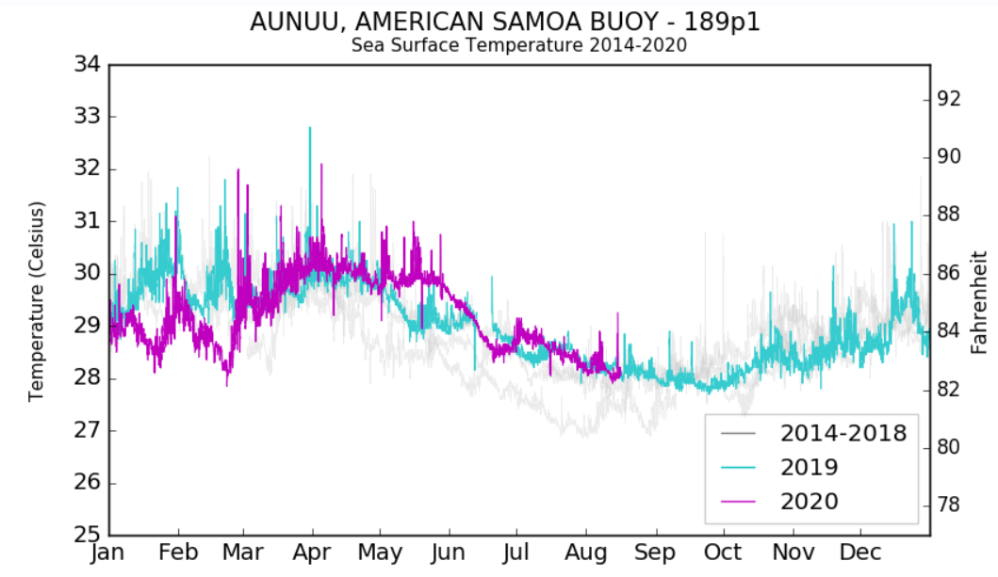
Question 8: Have recent, accelerated changes in climate altered water conditions and how are they changing?
Habitat: Shallow Habitats Indicator: Temperature
Source: CDIP
www.cdip.ucsd.edu

Slide 8
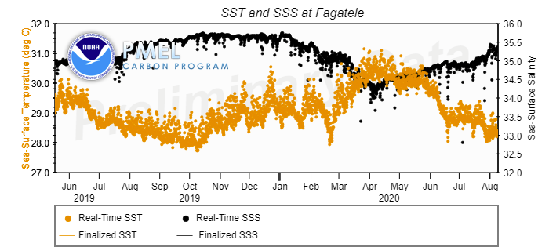
Question 8: Have recent, accelerated changes in climate altered water conditions and how are they changing?
Habitat: Shallow Habitats
Indicator: Temperature
Source: NOAA Pacific Marine Environmental Laboratory

Slide 9
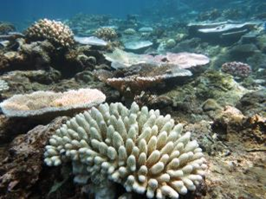
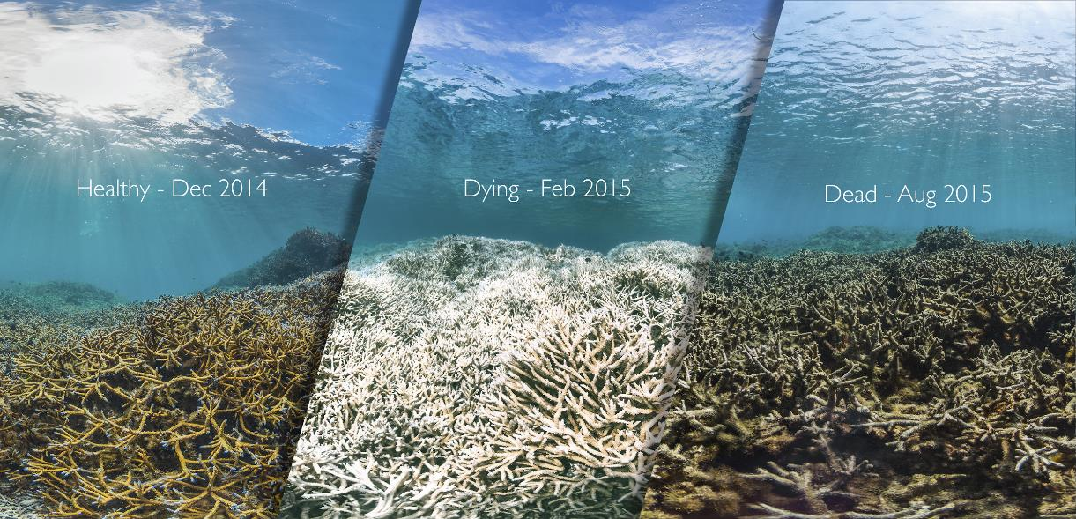
Question 8: Have recent, accelerated changes in climate altered water conditions and how are they changing?
Habitat: Coral Reefs
Indicator: Water Temperature
Photo credit NOAA (ASRAMP cruise 2015)
Source: Catlin Seaview
2015: NOAA recorded increased bleaching in February at the beginning of the bleaching season:
Fagatele: 25%
Rose: 2.3%
Swains: 5.9%
CRAG carried out some subjective bleaching assessments in 2017 and documented ~10% of bleaching in AS.
Source: NOAA
Notes:
Severe bleaching in 2015. Widely known example is the massive staghorn mortality in the airport pools (see Catlin Seaview image).
NOAA CREP conducted their American Samoa Reef Assessment and Monitoring Cruise (ASCRMP) between 15 February 2015 – 30 March 2015 and recorded data for the beginning of this bleaching event.
Second bleaching event recorded in 2017: No real quantitative data, only some subjective data collected by CRAG that documents widespread bleaching around the island of Tutuila.

Slide 10
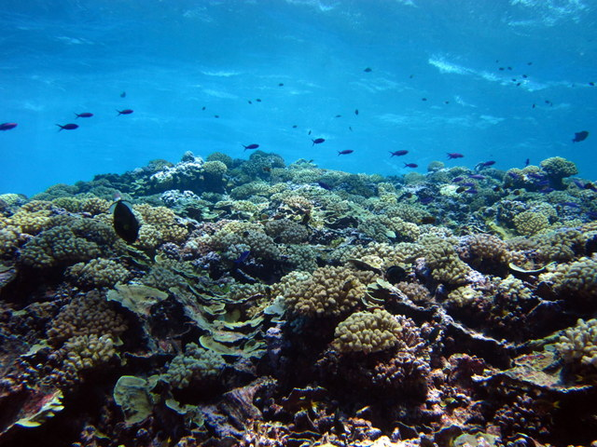
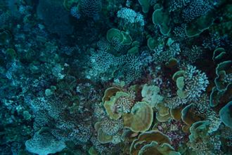
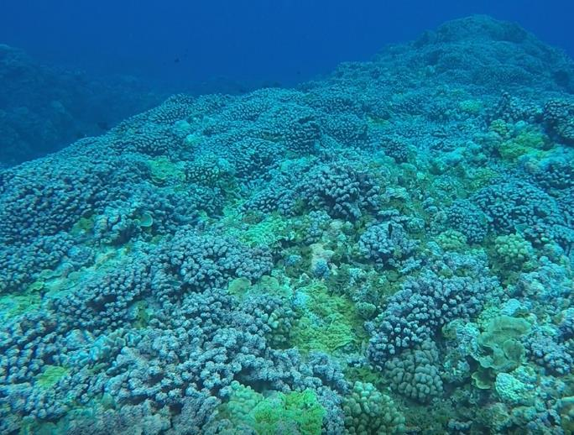
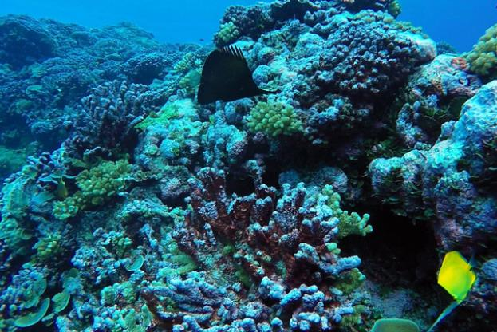
Question 8: Have recent, accelerated changes in climate altered water conditions and how are they changing?
Habitat: Coral Reefs Indicator: Water Temperature
Swains Island
>60% loss of Pocillopora colonies from 2015-2018
Source: ESD 2019
2010
2015
2017
2015
Bleached coral colonies on the reef slope at Swains island during February 2015.
Photo credit NOAA.
Source: NOAA (left) DMWR (right)
Notes:
Before 2015 Pocillopora was one of the dominant corals on the reef at Swains (see 2010 picture)
Bleaching in 2015 (see 2015 picture) and potential unrecorded bleaching in 2016.
Note high amount of dead Pocillopora covered in CCA in 2017 picture (documented on snorkel during a DMWR research trip to Swains).
Research cruise in 2018: ESD recorded a staggering >60% loss of Pocillopora colonies at Swains Island between 2015 and 2018.

Slide 11
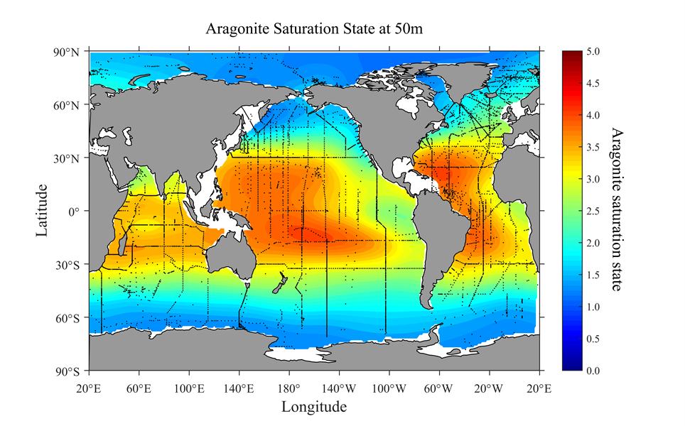
Question 8: Have recent, accelerated changes in climate altered water conditions and how are they changing?
Habitat:
All Shallow Habitats:
Rocky Shores, Sandy Shores and Reef Flat, Shallow Coral Reef, Mesophotic Coral Reef, Upper Pelagic
Source: NOAA
Indicator: Ocean Acidification
Notes:
NOAA: Ocean acidification is an often overlooked consequence of humankind's release of carbon dioxide emissions into the atmosphere from fossil fuel burning. Excess carbon dioxide enters the ocean and reacts with water to form carbonic acid, which decreases ocean pH (i.e., makes seawater less basic), and lowers carbonate ion concentrations. Organisms such as corals, clams, oysters, and some plankton use carbonate ions to create their shells and skeletons. Decreases in carbonate ion concentration will make it difficult for these creatures to form hard structures, particularly for juveniles. Ocean acidification may cause some organisms to die, reproduce less successfully, or leave an area. Other organisms such as seagrass and some plankton species may do better in oceans affected by ocean acidification because they use carbon dioxide to photosynthesize, but do not require carbonate ions to survive. Ocean ecosystem diversity and ecosystem services may therefore change dramatically from ocean acidification.
Aragonite saturation state is commonly used to track ocean acidification because it is a measure of carbonate ion concentration. Aragonite is one of the more soluble forms of calcium carbonate and is widely used by marine calcifiers (organisms with calcium carbonate structures).

Slide 12
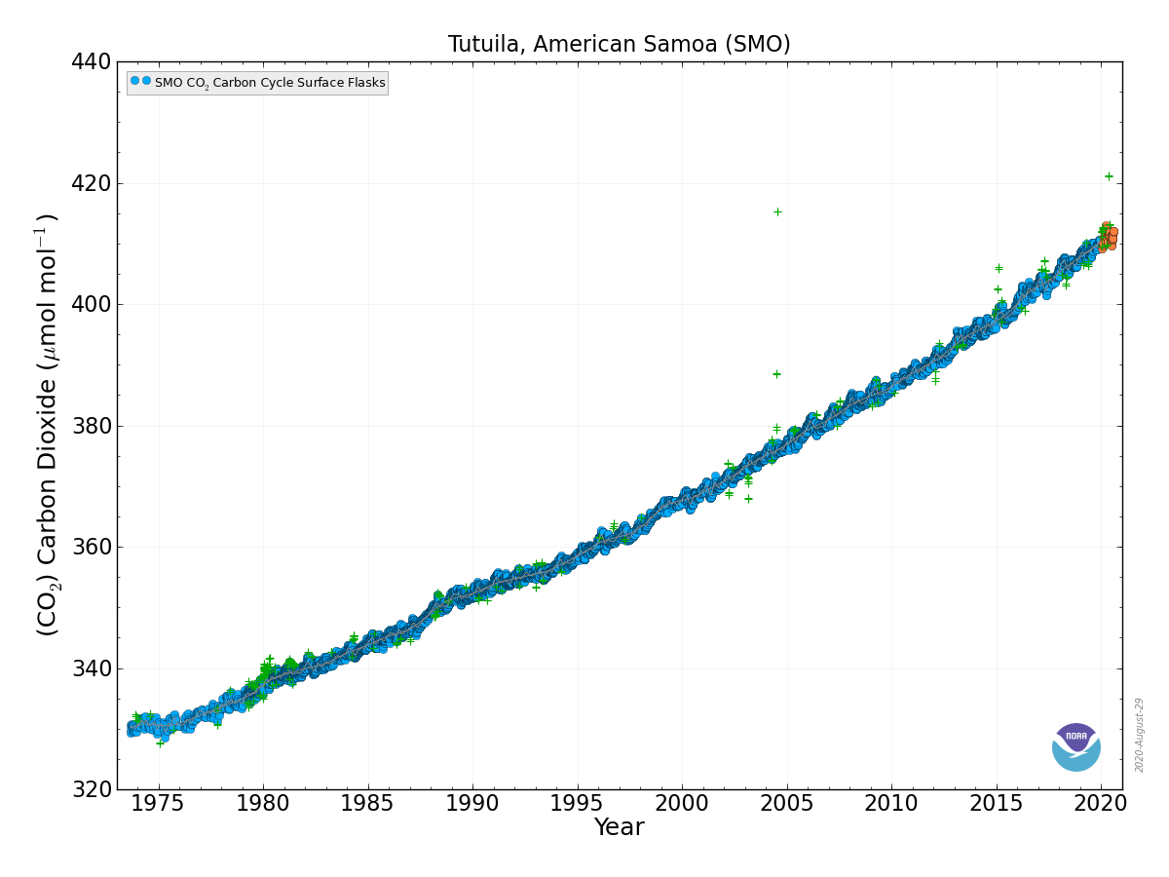
Question 8: Have recent, accelerated changes in climate altered water conditions and how are they changing?
Habitat: Shallow Habitats Indicator: Atmospheric CO2
Source: NOAA Global Monitoring Laboratory
Notes:
Long Term Carbon Dioxide Measurements from the NOAA Tula Observatory
https://www.esrl.noaa.gov/gmd/dv/data/index.php?site=SMO&parameter_name=Carbon%2BDioxide&frequency=Discrete
Data accessed 8/29/2020

Slide 13
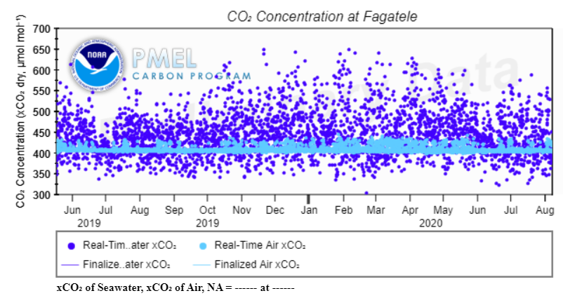
Question 8: Have recent, accelerated changes in climate altered water conditions and how are they changing?
Habitat: Coral Reefs
Indicator: CO2 Air & Seawater
Source: https://www.pmel.noaa.gov/co2/story/Fagatele+Bay
Notes:
The MAPCO2 Buoy in Fagatele Bay measures a suite of indicators, including air and seawater CO2.
These data are preliminary pending review of the dataset and sensor after refurbishment. This has unfortunately been delayed due to Measles and COVID.
The preliminary data however, shows us the variation in CO2 concentration in Fagatele Bay.
You’ll notice that there are natural diurnal fluxes in Carbon Dioxide in the water in Fagatele.
Short term data set but will provide valuable in-situ real time data into the future

Slide 14
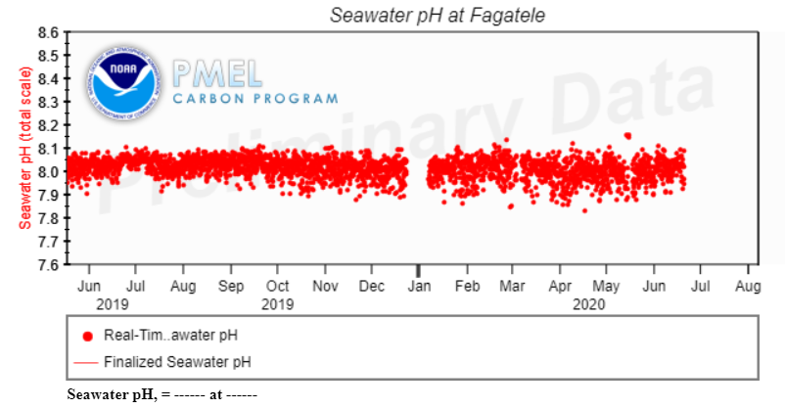
Question 8: Have recent, accelerated changes in climate altered water conditions and how are they changing?
Habitat: Coral Reefs
Indicator: pH
Source: https://www.pmel.noaa.gov/co2/story/Fagatele+Bay
Notes:
Looking at pH from the buoy, we notice that there are also natural diurnal fluxes in pH.
Short term data set but will provide valuable in-situ real time data into the future.
Again this is a preliminary dataset, so we should treat this with a little caution.

Slide 15
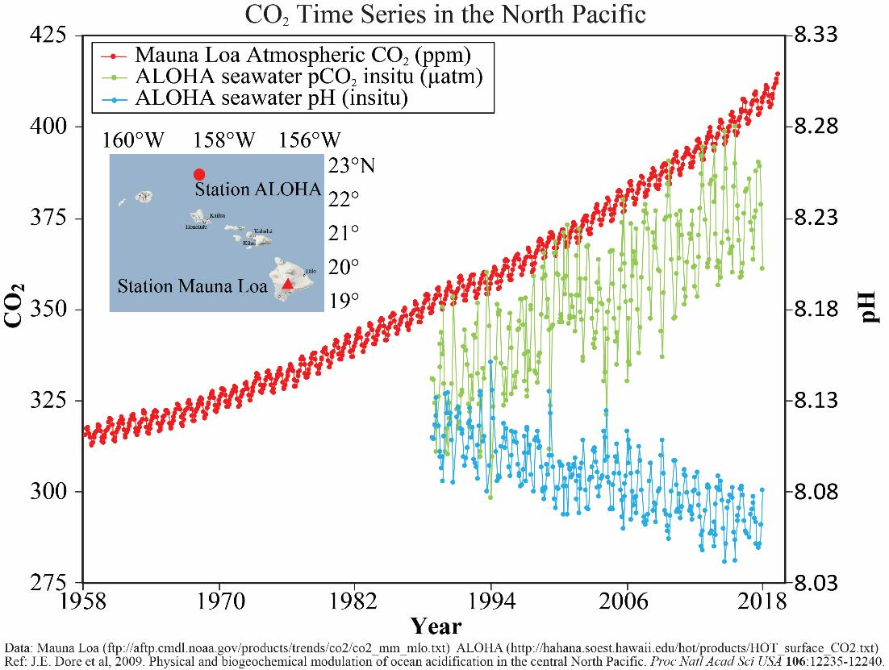
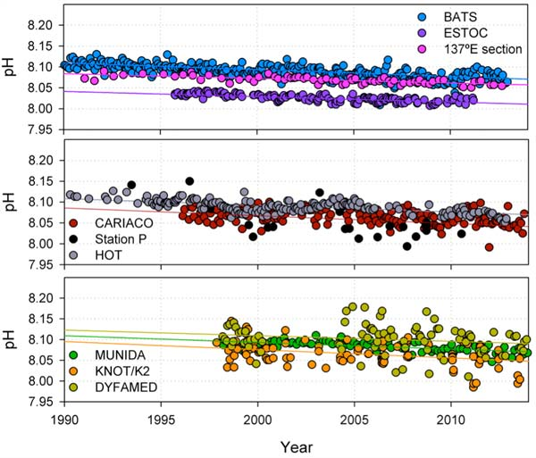
Question 8: Have recent, accelerated changes in climate altered water conditions and how are they changing?
Habitat: Shallow Habitats Indicator: Atmospheric CO2
Deseasonalized Surface Ocean pH Trends
Source: NOAA PMEL (left)
WMO (right)
Notes:
Long Term Carbon Dioxide and pH Measurements from the NOAA Mauna Loa Observatory and Station ALOHA
We don’t have long term fine scale pH monitoring data for the tropical South Pacific, but we do have data from Hawaii and New Zealand (MUNIDA station data in the bottom right graph) and other sites around the world. All of them are showing declining pH.
It is important to remind everyone that while these seem like small changes, pH is measured on a logarithmic scale.
https://www.pmel.noaa.gov/co2/files/co2_time_series_aloha_06-11-2019.jpg
Reference Dore et al 2009
World Meteorological Organization
https://public.wmo.int/en/resources/bulletin/monitoring-ocean-carbon-and-ocean-acidification-0
Munida, NZ pH data
http://archive.stats.govt.nz/browse_for_stats/environment/environmental-reporting-series/environmental-indicators/Home/Marine/ocean-acidification.aspx

Slide 16
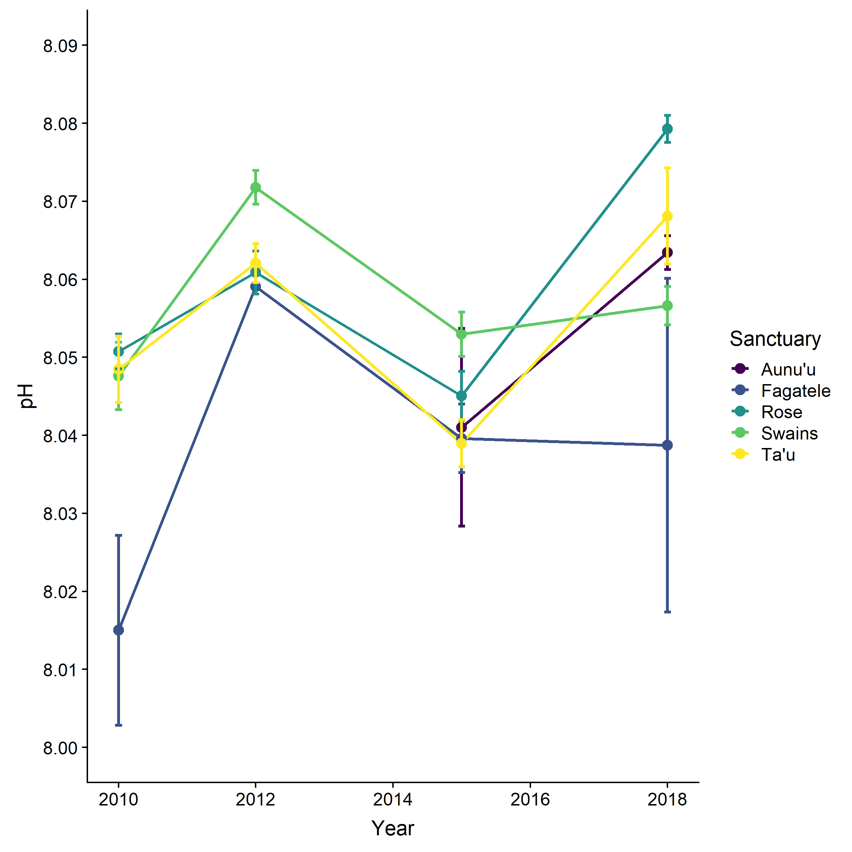
Question 8: Have recent, accelerated changes in climate altered water conditions and how are they changing?
Habitat: Coral Reefs Indicator: pH
The data at this point is not robust enough to detect temporal trends since 2010. However, there are some spatial differences. Notably, pH tends to be lower and more variable in Fagatele because the residence time of water is longer in the bay (Hannah Barkley, ESD).
Source: NOAA ESD
Notes:
We do have discrete samples from RAMP cruises conducted from 2010 – 2018
As we noted earlier, pH can vary on diurnal cycles near reefs, and this is particularly true for Fagatele as the embayment can increase residence time of water.
NOAA: Ranging from 0 to 14, pH is a scale that describes the acid and base properties of a solution. The ocean's surface has an average pH of around 8.1, which is slightly basic. The pH of the open ocean is relatively stable in both time and space; however, the uptake of CO2 by the ocean has caused measurable changes in seawater.
Although the pH changes appear small, pH is on a log scale meaning that a change of one unit represents an order of magnitude change in the acidity of the seawater. Ocean acidification, a lowering of ocean pH, has the potential to significantly impact marine ecosystems by the end of this century.

Slide 17
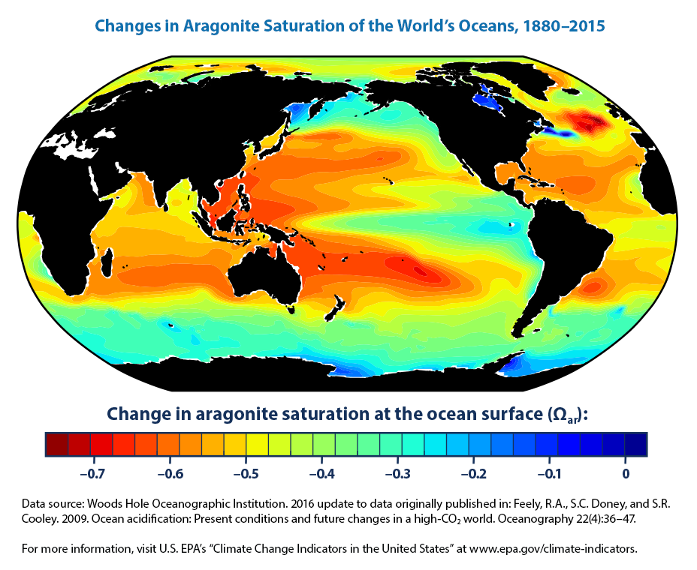
Question 8: Have recent, accelerated changes in climate altered water conditions and how are they changing?
Habitat: Coral Reefs Indicator: Aragonite
Source: USEPA / WHOI 2016
Notes:
https://www.epa.gov/climate-indicators/climate-change-indicators-ocean-acidity#ref8
This is a global model of changes in aragonite saturation for the world’s oceans from 1880 – 2015.
This model suggests that aragonite has likely declined in American Samoa over this time period. However…..
Woods Hole Oceanographic Institution. 2016 update to data originally published in: Feely, R.A., S.C. Doney, and S.R. Cooley. 2009. Ocean acidification: Present conditions and future changes in a high-CO₂ world. Oceanography 22(4):36–47.
The aragonite saturation state is projected to fall below 3.5 in Samoa by 2060

Slide 18
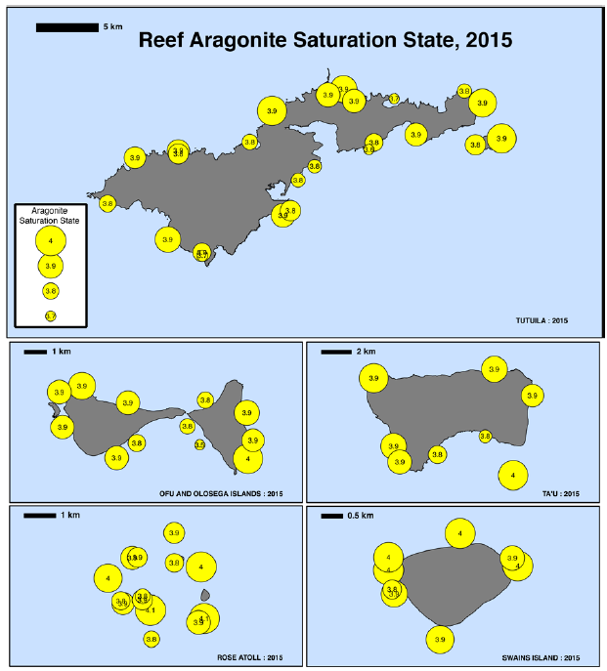
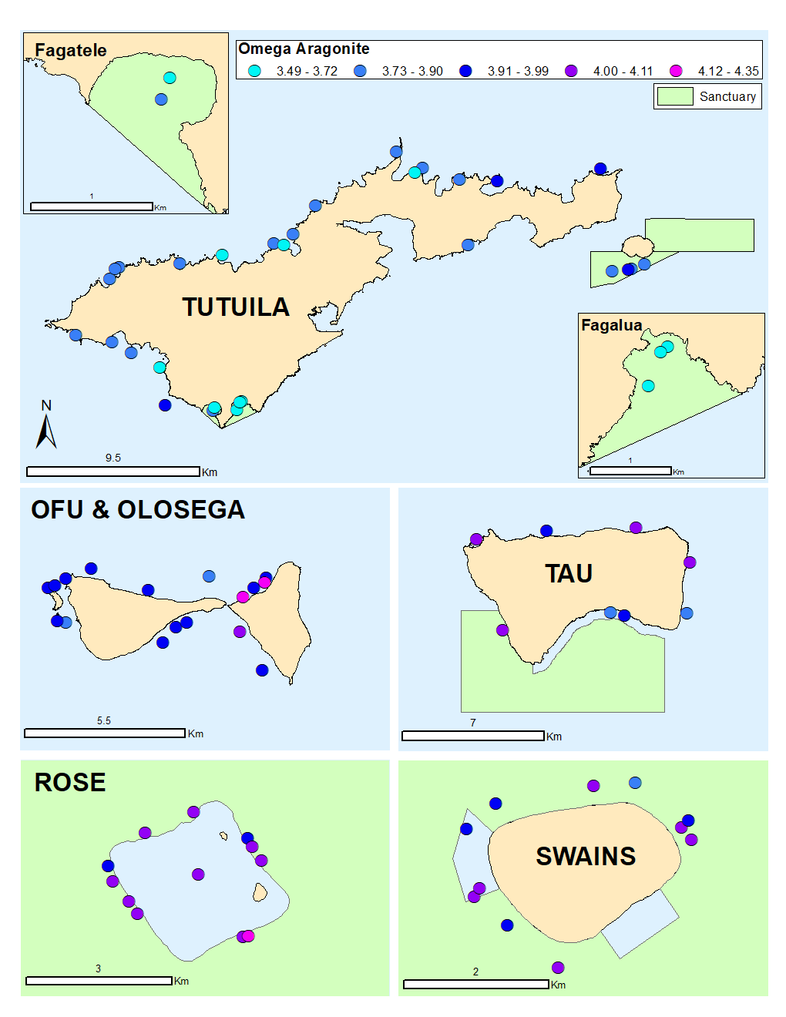
Question 8: Have recent, accelerated changes in climate altered water conditions and how are they changing?
2018
Habitat: Coral Reefs Indicator: Aragonite
Coral formation occurs optimally at saturation states above 4.0, declining to extremely marginal production at levels at and below 3.0
Source: ESD report 2016 & 2019
Notes:
Aragonite saturation state data for American Samoa remains some of the highest in the US Pacific Islands. In many places, this is still near optimal levels of 4.0 and has not demonstrated much temporal change. Rose is higher with a slight decrease in values moving towards Tutuila. Fagatele and Fagalua/Fogama’a are lower, but this may be due to biological demand.
The aragonite saturation state is projected to fall below 3.5 in Samoa by 2060
Aragonite saturation state (Omega aragonite) data was estimated based on discrete seawater samples analyzed for two parameters: Dissolved Inorganic Carbon (DIC) and Total Alkalinity (TA). Because the marine carbonate system is influenced by salinity, temperature, and pressure, these data were obtained from CTD casts and used during analysis with DIC and TA values to calculate values for omega aragonite. All carbonate system collection and measurement methodologies followed Dickinson et al. (2007).
Aragonite saturation state is commonly used to track ocean acidification because it is a measure of carbonate ion concentration. Aragonite is one of the more soluble forms of calcium carbonate and is widely used by marine calcifiers (organisms with calcium carbonate structures). Corals and other calcifiers are more likely to survive and reproduce when the saturation state is greater than three. When aragonite saturation state falls below 3, these organisms become stressed, and when saturation state is less than 1, shells and other aragonite structures begin to dissolve.
Omega aragonite values in American Samoa are traditionally the highest measured among the 48 island and atolls periodically visited by NOAA’s Pacific RAMP. Within the islands of American Samoa there is not a lot of temporal variation; Omega aragonite values were very similar between survey years 2015 and 2018. Also, Rose Atoll typically exhibits the highest omega aragonite levels and Tutuila has the lowest. Fagatele and Fagalua Sanctuary management areas have lower omega aragonite values than most of the forereef sampling locations, likely due to biological activity (e.g. calcification and respiration) that occurs in waters with a longer residence time similar to within these sheltered bays.
The aragonite saturation state is projected to fall below 3.5 in Samoa by 2060, and continue declining thereafter (ABM and CSIRO 2011).

Slide 19
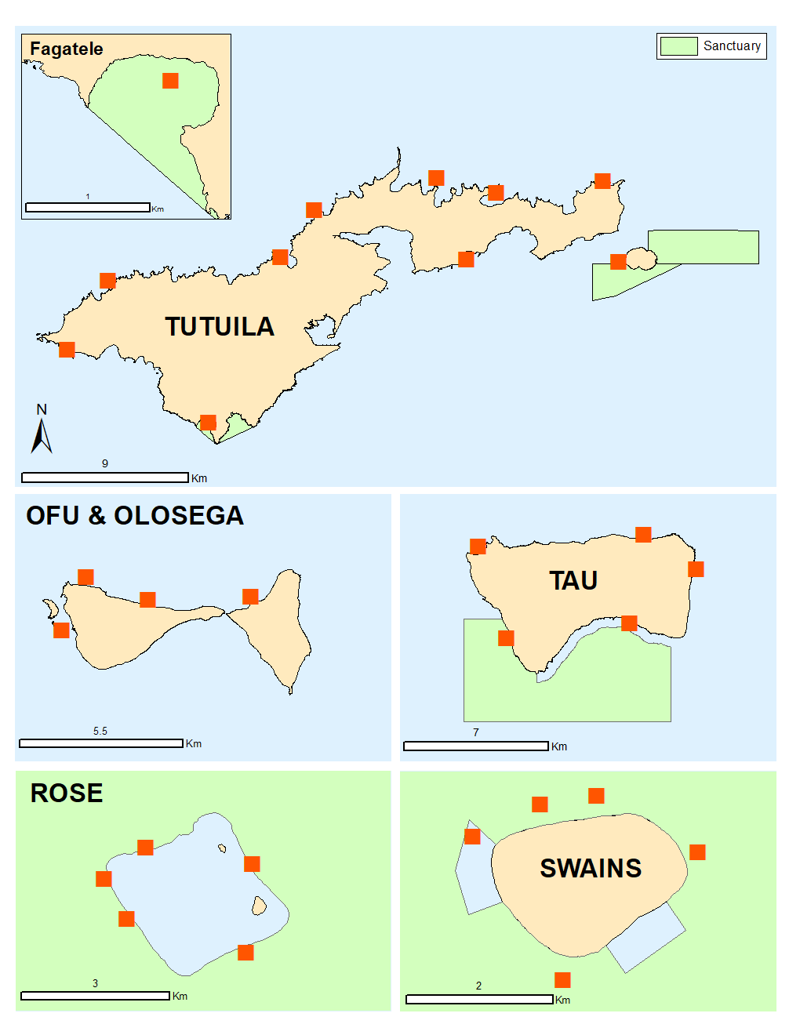
Question 8: Have recent, accelerated changes in climate altered water conditions and how are they changing?
Habitat: Coral Reefs
Indicator: Calcification
Spatial distribution and locations of Calcification Accretion Units (CAUs) recovered around American Samoa.
Data not yet fully analyzed and not yet available
Notes:
Update 5/27/2020
Ari Halperin (ESD OC Tech): “In terms of the AS CAUs, we were so close to finishing off the Rose plates right before we shut down for COVID, and they were the last of the batch! But unfortunately, the data isn't ready yet. As soon as they reopen the office, those plates should be done within 2 weeks to a month, we do some data QC, and then it should be ready for you! I'd like to think we can make the August/September report time, but I'm really not sure when we're going to get back to the office to finish the last of the lab work. Do you want to touch base in early-mid August and we can see how we're doing with the dataset?”

Slide 20
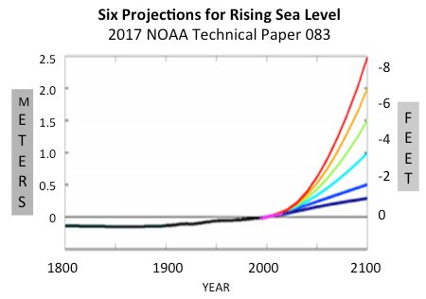
Question 8: Have recent, accelerated changes in climate altered water conditions and how are they changing?
Habitat:
Nearshore Shallow Habitats:
Rocky Shores, Sandy Shores and Reef Flat, Shallow Coral Reef
Indicator:
Sea level rise
Notes:
NOAA: Global sea level has been rising over the past century, and the rate has increased in recent decades. In 2014, global sea level was 2.6 inches above the 1993 average—the highest annual average in the satellite record (1993-present). Sea level continues to rise at a rate of about one-eighth of an inch per year. With continued ocean and atmospheric warming, sea levels will likely rise for many centuries at rates higher than that of the current century.

Slide 21
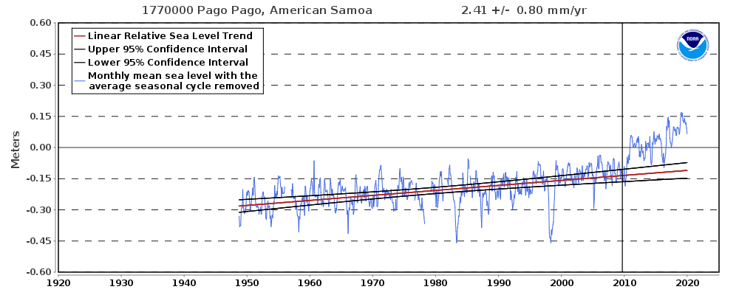
Question 8: Have recent, accelerated changes in climate altered water conditions and how are they changing?
Habitat: Nearshore Shallow Habitats Indicator: sea level rise
Source: https://tidesandcurrents.noaa.gov/sltrends/sltrends_station.shtml?id=1770000
Notes:
The relative sea level trend is 2.41 millimeters/year with a 95% confidence interval of +/- 0.8 mm/yr based on monthly mean sea level data from 1948 to 2009 which is equivalent to a change of 0.79 feet in 100 years.
Trend is based only on data before September 2009 earthquake
However, over the last decade, sea level has increased more rapidly, for a total increase of approximately 25 cm or 9 inches.
https://tidesandcurrents.noaa.gov/sltrends/sltrends_station.shtml?id=1770000

Slide 22
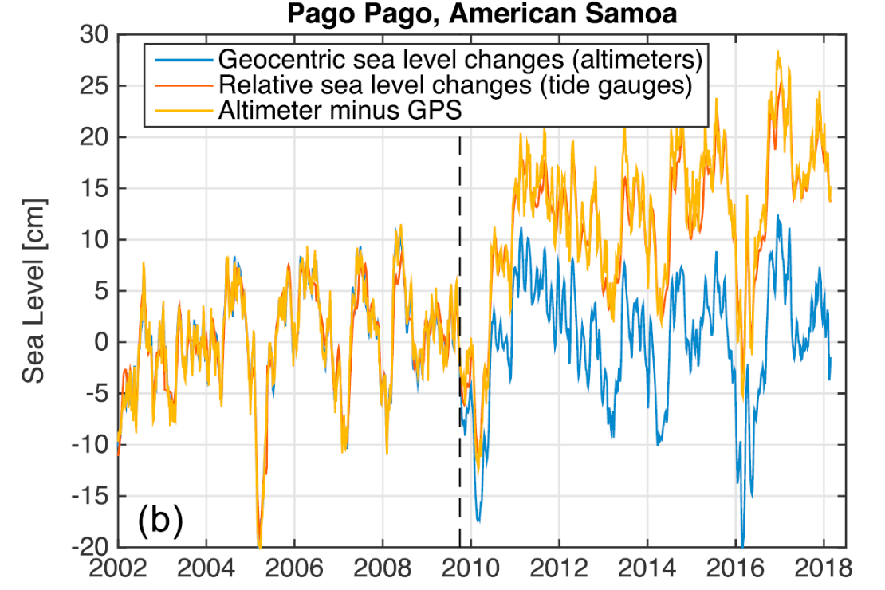
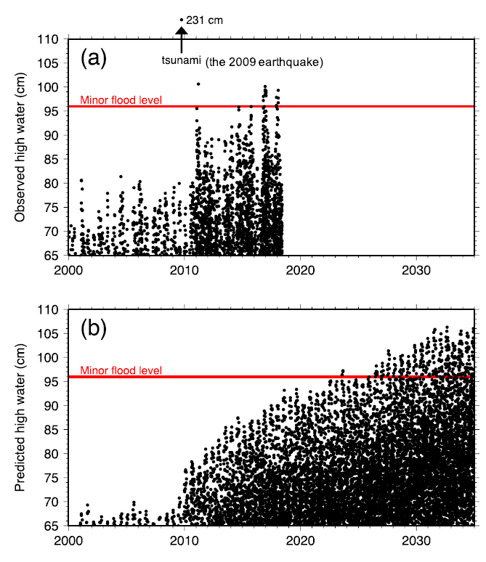
Question 8: Have recent, accelerated changes in climate altered water conditions and how are they changing?
Habitat: Nearshore Shallow Habitats Indicator: sea level rise
Source: Han et al 2019
Notes:
Due to subsidence after the 2009 earthquake doublet along the Tongan trench
Sea level is effectively rising 5 times faster than the global average. And this trend is expected to continue.
The islands have experienced sea level rise by 2–3 mm/year during the last half century. The rate, however, has dramatically increased following the Mw 8.1 Samoa‐Tonga earthquake doublet (megathrust + normal faulting) in September 2009. Since the earthquake, we found large‐scale gravity increase (0.5 μGal/year) around the islands and ongoing subsidence (8–16 mm/year) of the islands from our analysis of Gravity Recovery And Climate Experiment gravity and GPS displacement data. The postseismic horizontal displacement is faster in Samoa, while the postseismic subsidence rate is considerably larger in American Samoa. The analysis of local tide gauge records and satellite altimeter data also identified that the relative sea level rise becomes faster by 7–9 mm/year in American Samoa than Samoa. A simple viscoelastic model with a Maxwell viscosity of 2–3×1018 Pa s for the asthenosphere explained postseismic deformation at nearby GPS sites as well as Gravity Recovery And Climate Experiment gravity change. It is found that the constructive interference of viscoelastic relaxation from both megathrust and normal faulting has intensified the postseismic subsidence at American Samoa, causing ~5 times faster sea level rise than the global average. Our model indicates that this trend is likely to continue for decades and result in sea level rise of 30–40 cm, which is independent of and in addition to anticipated climate‐related sea level rise. It will worsen coastal flooding on the islands leading to regular nuisance flooding.

Slide 23
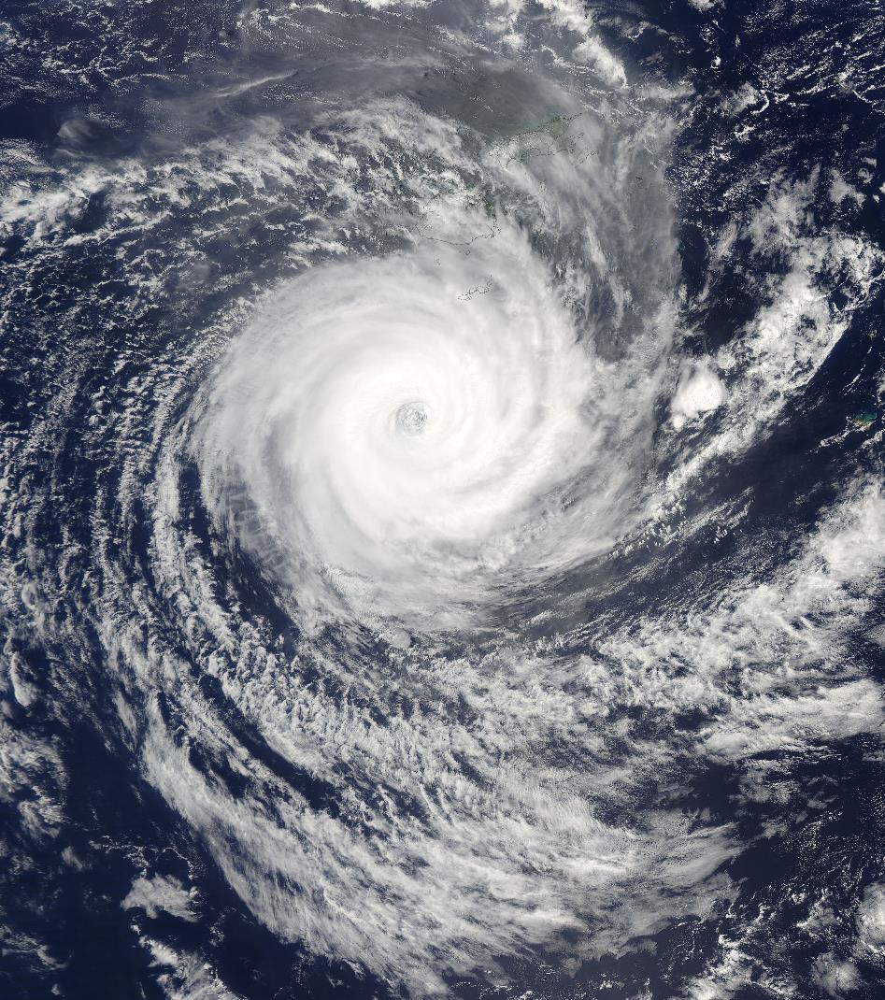
Question 8: Have recent, accelerated changes in climate altered water conditions and how are they changing?
Habitat:
Nearshore Shallow Habitats:
Rocky Shores, Sandy Shores and Reef Flat, Shallow Coral Reef
Indicator:
Tropical Cyclones

Slide 24
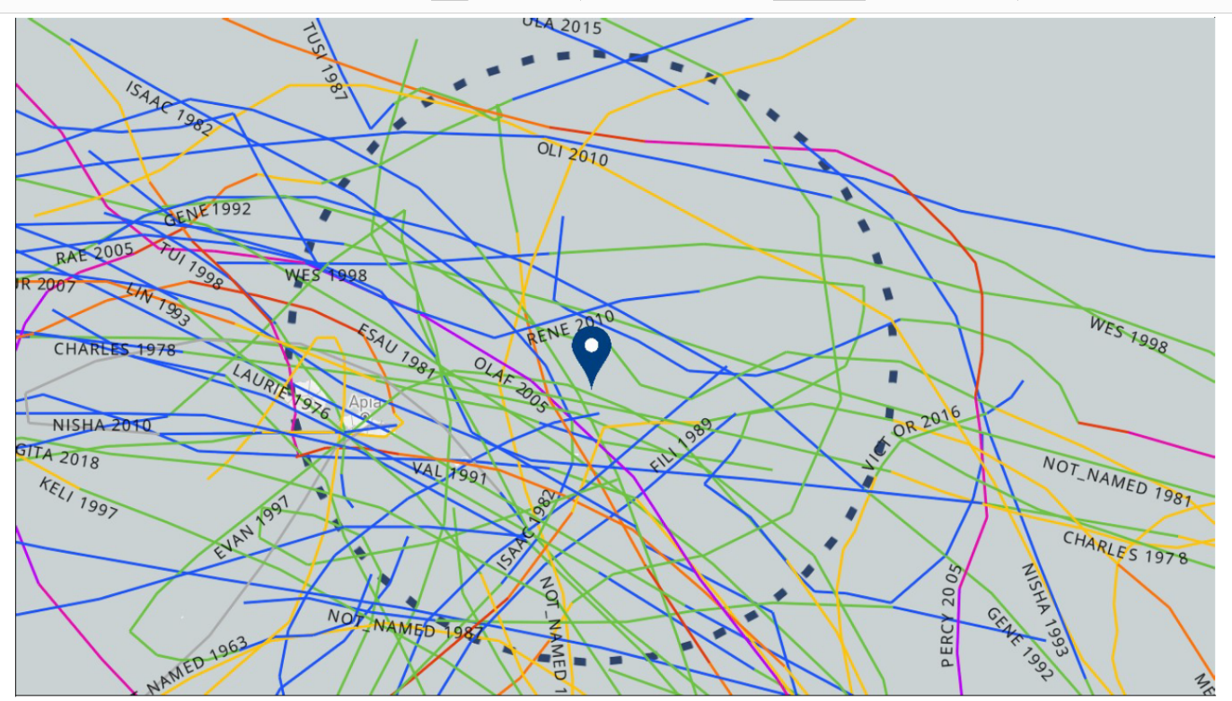
Question 8: Have recent, accelerated changes in climate altered water conditions and how are they changing?
Habitat: Shallow Habitats
Indicator: Cyclones
Tropical Cyclones from 1959-2020
Source: https://coast.noaa.gov/
Notes:
Cyclones
35 Tropical Cyclones have passed within 100 nm of Tutuila since 1959.
Climate Change is expected to decrease the number of cyclones in this region, but storms are expected to be stronger.
Most of these storms passed American Samoa while at Tropical Depression or Storm level.
Exceptions to this were Renee in 2010 (H3 E of Ta’u), Olaf 2005 (Cat 5), Val in 1991 (Cat 2 direct to Tutuila), Tusi 1987 ( H2 Ta’u Fituta), Unnamed (H1 1959)
NOAA Digital Coast – Historical Hurricane Tracks
Search for 100nm from Tutuila
https://bit.ly/3bdex5v

Slide 25
Question 8: Have recent, accelerated changes in climate altered water conditions and how are they changing?
Habitat: Shallow Habitats
Indicator: Cyclones
Source: https://coast.noaa.gov/
Notes:
Cyclones
54 Tropical Cyclones have passed within 100 nm of Tutuila since 1959.
Climate Change is expected to decrease the number of cyclones in this region, but storms are expected to be stronger.
Most of these storms passed American Samoa while at Tropical Depression or Storm level.
Exceptions to this were Renee in 2010 (H3 E of Ta’u), Olaf & Percy 2005 (Cat 5), Val in 1991 (Cat 2 direct to Tutuila), Tusi 1987 ( H2 Ta’u Fituta), Unnamed (H1 1959)
NOAA Digital Coast – Historical Hurricane Tracks
Search for 200nm from a central point that included Rose and Swains
https://bit.ly/2G9Pntb

Slide 26
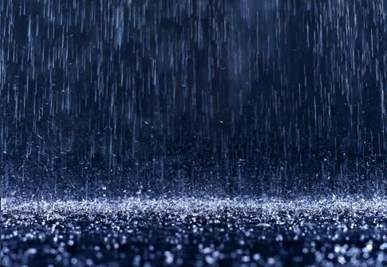
Question 8: Have recent, accelerated changes in climate altered water conditions and how are they changing?
Habitat:
Nearshore Shallow Habitats:
Rocky Shores, Sandy Shores and Reef Flat, Shallow Coral Reef
Indicator:
Rainfall

Slide 27
Question 8: Have recent, accelerated changes in climate altered water conditions and how are they changing?
Habitat: Nearshore Shallow Habitats Indicator: Rainfall
Rainfall Variations During ENSO
American Samoa Seasonal Rainfall Variations During ENSO
(Values are % of normal)
El Nino | Year (0) | Year (+1)
 | 103-116% | 92-109%
La Nina | Year (0) | Year (+1)
 | 87-114% | 72-99%
Source: NOAA WSO Pago Pago
Notes:
Rainfall can affect coastal habitats due to shifts in salinity, non-point source pollution, and sedimentation linked to rainfall events.
Slight increasing trend in total precipitation. May be affected by ENSO, but we weren’t able to locate any analysis of patterns to see if this is linked to more extreme events (which could exacerbate effects) or a general trend.
Keener et al 2018: Using global climate model results for the lower scenario (RCP4.5), in American Samoa, rainfall is projected to increase by up to 10% by mid-century compared with the present, with additional slight increases by the end of the century. In American Samoa, drought magnitude and duration have minimal decreasing trends.
Extreme heavy rainfall events causes increased runoff, erosion, and flooding.
Keener, V., D. Helweg, S. Asam, S. Balwani, M. Burkett, C. Fletcher, T. Giambelluca, Z. Grecni, M. Nobrega-
Olivera, J. Polovina, and G. Tribble, 2018: Hawai‘i and U.S.-Affiliated Pacific Islands. In Impacts, Risks, and Adaptation in the United States: Fourth National Climate Assessment, Volume II [Reidmiller, D.R., C.W. Avery, D.R. Easterling, K.E. Kunkel, K.L.M. Lewis, T.K. Maycock, and B.C. Stewart (eds.)]. U.S. Global Change Research Program, Washington, DC, USA, pp. 1242–1308. doi: 10.7930/NCA4.2018.CH27

Slide 28
Question 8: Have recent, accelerated changes in climate altered water conditions and how are they changing?
Habitat: Shallow Habitats
Indicator: Cyclones
Source: https://coast.noaa.gov/
NOAA WSO Pago Pago
Notes:
Charted the precipitation data with storms, but there doesn’t seem to be a clear trend. This may be due to the distance of some storms from WSO Pago Pago measuring devices.
NOAA Digital Coast – Historical Hurricane Tracks
Search for 100nm from Tutuila
https://bit.ly/2G9Pntb

Slide 29
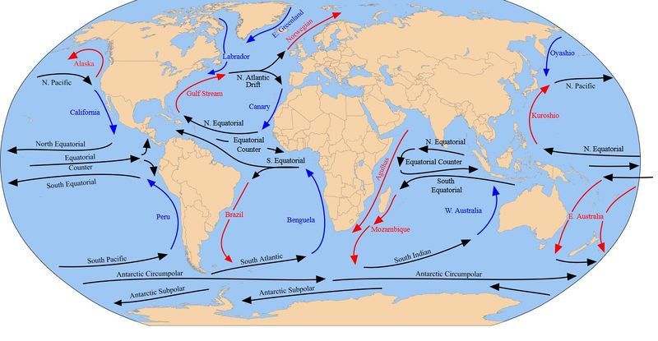
Question 8: Have recent, accelerated changes in climate altered water conditions and how are they changing?
Habitat:
All Habitats
Indicator:
Currents

Slide 30
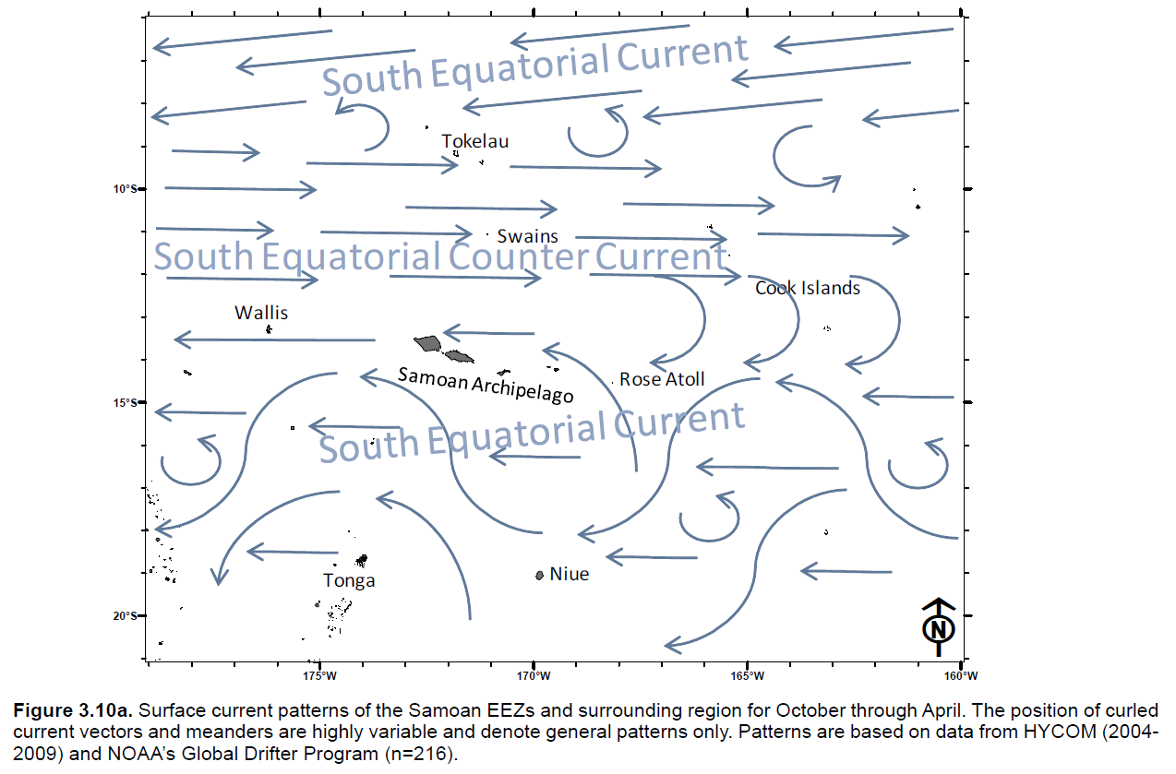
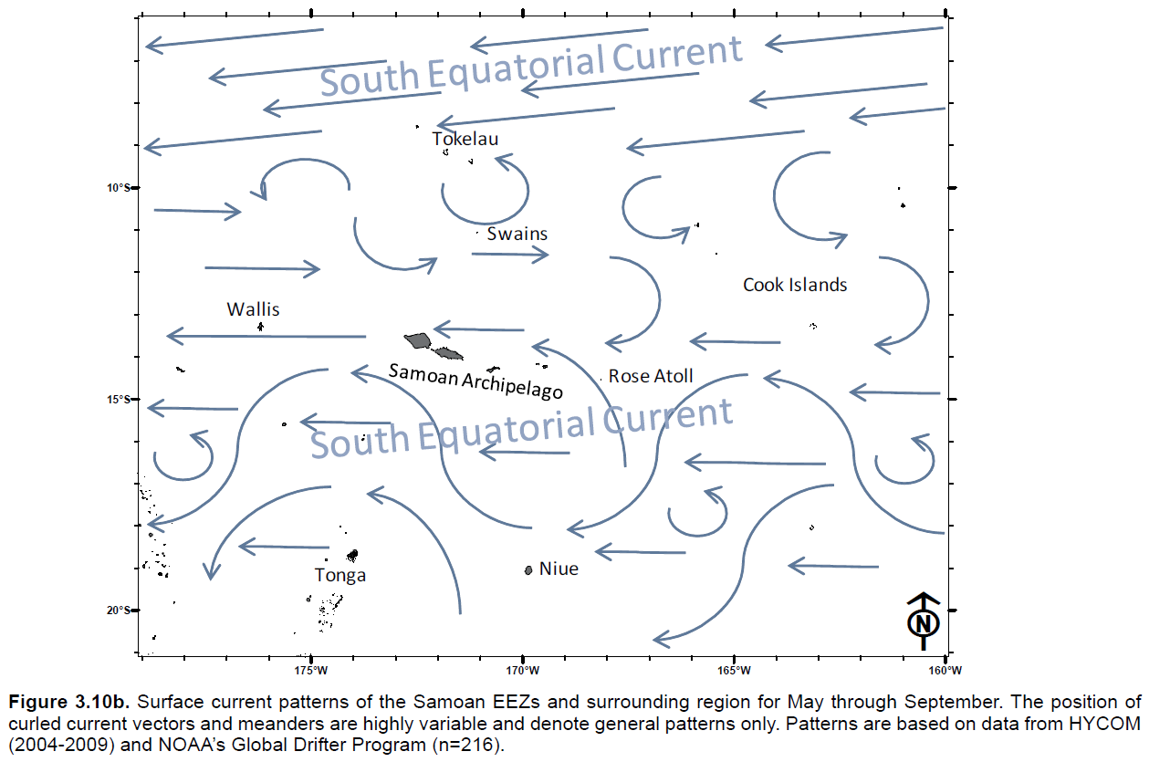
Question 8: Have recent, accelerated changes in climate altered water conditions and how are they changing?
Habitat: Shallow Habitats
Indicator: Currents
Source: BioGeo Assessment
Notes:
The SEC is expected to weaken with warming conditions (Luo and Rothstein 2011). However, there does not seem to be any targeted assessment of this indicator.
Currents generally move westward via the SEC from Rose towards Tutuila and on to Upolu and Savaii, however, the SECC can entrain larvae from Samoa in October / November and bring it towards American Samoa. This may be important for species with longer Pelagic Larval Durations.
Swains and Rose are quite distant from larval sources and may be particularly vulnerable to changes in current strength.

Slide 31
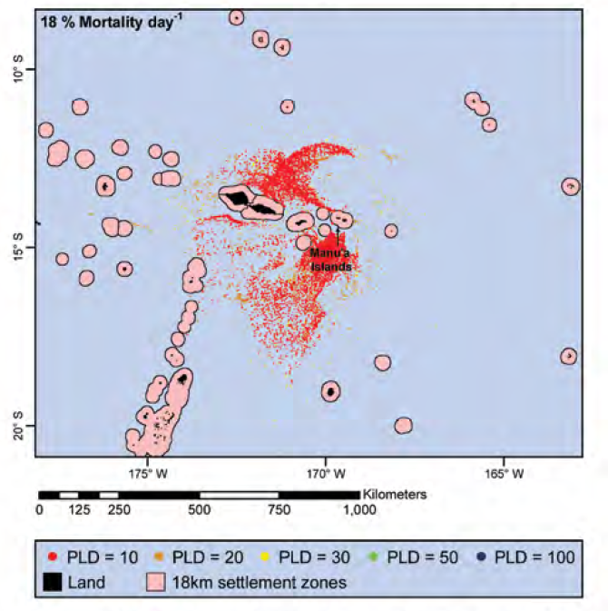
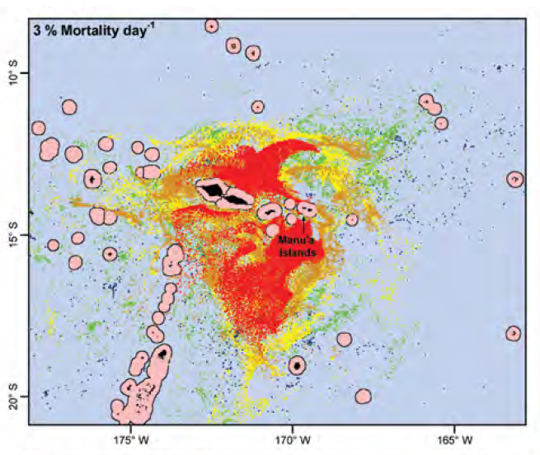
Question 8: Have recent, accelerated changes in climate altered water conditions and how are they changing?
Habitat: Coral Reefs
Indicator: Currents - Larval Transport
Source: NCCOS 2011
Notes:
The importance of these currents becomes more obvious when we look at modeled larval dispersion from the Biogeographic Assessment released in 2011 by NCCOS. As an example, here you can see virtual larvae from the Manu’a islands.
20% of larvae with a short PLD may be retained in Manua, but less for longer larval durations. Larvae with longer PLD likely spread to Tutuila, seamounts, and as far west as Wallis depending on the PLD and mortality.
The Manu’a Islands themselves are reliant on outside larval sources for a wide range, 0-90%, of their arriving larvae depending on PLD and daily mortality rate. These likely come from Tutuila and Samoa via the SECC.
Slowing currents may affect these transport patterns.
Nearly all larvae with a 100 day PLD are from outside sources whereas a high proportion of self seeding occurs for larvae in the 10-30 day PLD range. For longer PLDs, sources include Tutuila and Samoa with larvae entrained in the eastward flowing SECC and then fed back south along the Samoan Archipelago including Manu’a in the 50-100 day range. Small but measurable contributions to the larvae arriving at Manu’a in the low to moderate mortality rate scenarios are from Tokelau to the north and Pukapuka and Nassau, and Suwarrow to the east.
You’ll notice that
The Manu’a Islands of Ta’u, Ofu, and Olosega represent the last moderately sized source of larvae in the Samoan Archipelago. Larvae from Manu’a split into two groups, one along the northern side of the Samoan Archipelago and another that is cast southwestward into the region of the Tonga Trench Eddy. Many in the northern trajectory are entrained in the SEC and transported well south of Swains where they mostly expire in the open ocean between the Samoan Archipelago and the Cook Islands. Over 20% of the larvae spawned at Manu’a are retained there for the 10 day PLD and low mortality scenario. Much smaller fractions of local production are retained locally for longer PLDs and higher mortality scenarios. Larvae settle along the archipelago on the seamounts, Tutuila, and the islands of Samoa in similar proportions. Larvae are then spread farther westward reaching Wallis and nearby islands and seamounts in the 50-100 day range in the low to moderate mortality scenarios.
Sources
The Manu’a Islands are reliant on outside larval sources for a wide range, 0-90%, of their arriving larvae depending on PLD and daily mortality rate. Nearly all larvae with a 100 day PLD are from outside sources whereas a high proportion of self seeding occurs for larvae in the 10-30 day PLD range. For longer PLDs, sources include Tutuila and Samoa with larvae entrained in the eastward flowing SECC and then fed back south along the Samoan Archipelago including Manu’a in the 50-100 day range. Small but measurable contributions to the larvae arriving at Manu’a in the low to moderate mortality rate scenarios are from Tokelau to the north and Pukapuka and Nassau, and Suwarrow to the east.

Slide 32
Question 8: Have recent, accelerated changes in climate altered water conditions and how are they changing?
Habitat:
Deep Habitats
Indicator:
Stratification and Thermohaline Circulation
Notes:
Figure – NASA in FBNMS climate report

Slide 33
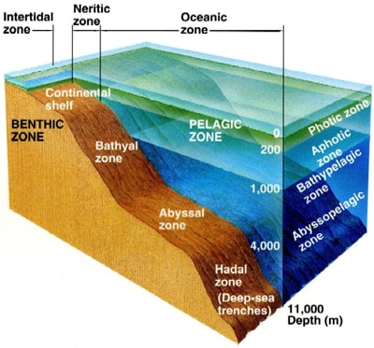
Question 8: Have recent, accelerated changes in climate altered water conditions and how are they changing?
Zonation by Depth in NMSAS
UPPER BATHYAL: bottom fish and precious coral habitats at depths between 250 m and 700 m. At this depth range, structuring of biological communities associated with depth was observed, likely a result of the rapid temperature changes in the main thermocline.
LOWER BATHYAL: depths between 700 m and 1,150 m and 2000 - 3000 m showed different communities compared to other depth ranges.
ABYSSAL: At depths between 3,700 m and 4,000 m organisms were similar to lower bathyal depths but species appeared to be different and their sizes were generally smaller.
Source: https://marinebio.org/oceans/deep-sea/
Source: NOAA OER
Notes:
Recent expeditions have suggested that biological communities appear to be structured by depth. Temperature may be particularly important in the 250-750m zone.
Further analyses are required to test the significance of the observed general patterns of depth structuring and to assess the potential impacts of climate change.
Important to note that habitat structuring organisms are slow growing, and in some places no recent recruitment was observed. Not clear if this is an emerging impact of changing conditions or just the normal pattern in deep sea succession.
Temperature, salinity, and DO were collected, but have not been analyzed for trends at this time.

Slide 34
Question 8: Have recent, accelerated changes in climate altered water conditions and how are they changing?
Previous rating
2007 rating based on | Increasing number of warm-water events causing coral bleaching
The purpose of this question is to capture shifts in water quality, and associated impacts on sanctuary resources, due to climate change. Though temporal changes in climate have always occurred on Earth, evidence is strong that changes over the last century have been accelerated by human activities. Indicators of climate change in sanctuary waters include water temperature, acidity, sea level, upwelling intensity and timing, storm intensity and frequency, changes in erosion and sedimentation patterns, and freshwater delivery (e.g., rainfall patterns). Climate-related changes in one or more of these indicators can impact the condition of habitats, living resources, and maritime archaeological resources in sanctuaries.
Increasing water temperature has been linked to changing growth rates, reduced disease resistance, and disruptions in symbiotic relationships (e.g., bleaching on coral reefs), and changes in water temperature exposure may affect a species’ resistance or the capacity to adapt to disturbances. Acidification can affect the survival and growth of organisms throughout the food web, as well as the persistence of skeletal material after death (through changes in rates of dissolution and bioerosion). Recent findings also suggest acidification impacts at sensory and behavioral levels, which can alter vitality and species interactions. Sea level change alters habitats, as well as their use and persistence. Variations in the timing and intensity of upwelling is known to change water quality through factors such as oxygen content and nutrient flow, further disrupting food webs and the natural functioning of ecosystems. Changing patterns and intensities of storms alter community resistance and resilience within ecosystems that have, over long periods of time, adapted to such disturbances. Altered rates and volumes of freshwater delivery to coastal ecosystems affects salinity and turbidity regimes and can disrupt reproduction, recruitment, growth, disease incidence, phenology, and other important processes.
Notes:
34

Slide 35
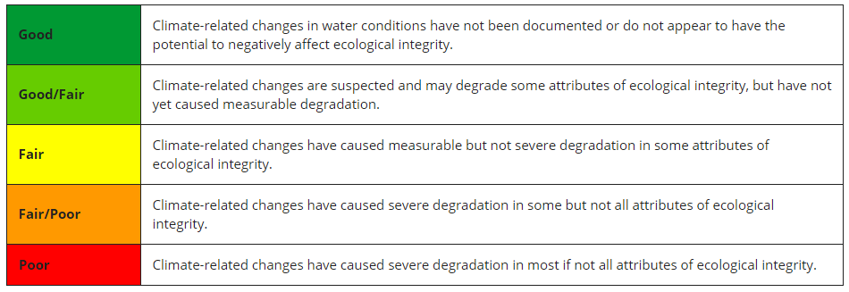
Indicator | Habitat | Data Summary
Indicator #1 Temperature | Shallow Habitats | Rising temperatures causing more frequent bleaching events.
Indicator #2 OA | Shallow Habitats | Global pH is decreasing. Lack of trend data for this region. Aragonite saturation has been stable and highest values in the US islands.
Indicator #3 Sea Level Rise | Nearhsore Habitats | Sea level has risen 9 inches since 2009. Climate impact exacerbated by subsidence from 2009 earthquake doublet.
Indicator #4 Rainfall | Nearshore Habitats | Slight increasing trend, not clear if these are linked to extreme events.
Indicator #5 Currents | Shallow Habitats | Lack of data to assess changes at this time.
Indicator #5 Stratification and Thermohaline Circ. | Deep Habitats | Lack of data. Evidence of temperature related zonation, but no analysis of temperature data or deep circulation.
Notes:
Likely Good / Fair or Fair when considering the full range of habitats
35

Slide 36
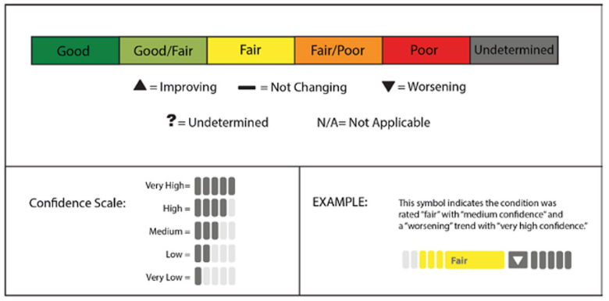
Question 8: Have recent, accelerated changes in climate altered water conditions and how are they changing?
Notes:
36

Slide 37
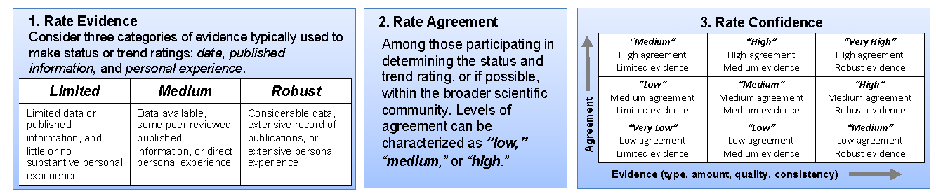
Capturing Expert ‘Confidence’
Question | New Rating | Evidence (limited, medium, robust) | Agreement (low, medium, or high) | Confidence (very low, low, medium, high, or very high) | Notes
Question 8 | Status: Fair | Robust for temp / pH Limited for currents, deep sea Medium overall | High | High | Temperature and pH data shows clear changes. Bleaching mortality is low, but events are more frequent and longer. Sea level exacerbated by subsidence may not be CC. Tutuila / Swains may have worse climate impacts, Manu’a seems to be ok. Note that Swains may be in Poor.
 | Trend: Worsening | Medium overall Robust for temp / pH, Limited for O2 currents, deep sea | High | High | Need to capture that temperature and pH is robust, others limited. Note data is more limited for outer islands.
1. Rate Evidence
2. Rate Agreement
3. Rate Confidence
Consider three categories of evidence typically used to make status or trend ratings: data, published information, and personal experience.
Among those participating in determining the status and trend rating, or if possible, within the broader scientific community. Levels of agreement can be characterized as “low,” “medium,” or “high.”
“Medium” High agreement Limited evidence | “High” High agreement Medium evidence | “Very High” High agreement Robust evidence
“Low” Medium agreement Limited evidence | “Medium” Medium agreement Medium evidence | “High” Medium agreement Robust evidence
“Very Low” Low agreement Limited evidence | “Low” Low agreement Medium evidence | “Medium” Low agreement Robust evidence
Agreement
Evidence (type, amount, quality, consistency)
Notes:
Use this slide to summarize the confidence scoring of workshop experts for each question. If experts differ in their opinions on amount of evidence or agreement on the rating, you may want to capture the number of experts who voted for different categories.

